Slide 1

INTERNSHIP PRESENTATION
Name: Mr. Palash D. Dangat
Class: TEIT
Roll no.: TI20
PRN: 72240755G
Academic Year: 2024 - 25

Slide 2
CONTENT:
Introduction of Company
Internship Technology
Problem Statement
Problem Objective
Result
Internship Certificate
References

Slide 3

CodTech IT Solutions Private Limited
‘CODTECH IT SOLUTIONS’ empowers startups with market strategies, sales training, technology solutions, and more. We also specialize in building custom websites and applications to elevate your digital presence.

Slide 4
INTERNSHIP TECHNOLOGY
Data Analytics refers to the process of examining, cleaning, transforming, and interpreting data to extract useful insights, support decision-making, and identify patterns or trends.
Libraries Used
Python 3.x
Pandas, NumPy, Matplotlib, Seaborn (EDA & Visualization)
Scikit-learn (Modeling and Evaluation)
Imbalanced-learn (SMOTE for resampling)
The dataset contains anonymized credit card transactions,
The dataset can be downloaded from Kaggle: Credit Card Fraud Detection Dataset

Slide 5
Problem Statement
Build a machine learning model using credit card transaction data to detect fraudulent activities. The solution involves:
Preprocessing the dataset (cleaning, handling imbalances).
Training a classification model to predict fraud.
Evaluating performance using precision, recall, and F1-score.

Slide 6
Problem Objective
The objective of this project is to build a machine learning model that can accurately detect fraudulent credit card transactions in real-time. This involves:
✅ Identifying fraud patterns from transaction data. ✅ Minimizing false positives and false negatives to balance security and customer experience. ✅ Handling class imbalance, as fraud cases are significantly fewer than legitimate transactions. ✅ Improving fraud detection efficiency using precision, recall, and F1-score.

Slide 7
Result/Output:
The software and tools used were:
Jupyter Notebook – For development and deployment.
Python – It is the programming language used.
Pandas – For Data Manipulation.
NumPy – For Numerical Computations.
Matplotlib & Seaborn – For Data Visualization.
Scikit-learn – For Data Preprocessing and Model Evaluation.
As the project was official there is restriction to include the images and codes related to it.

Slide 8
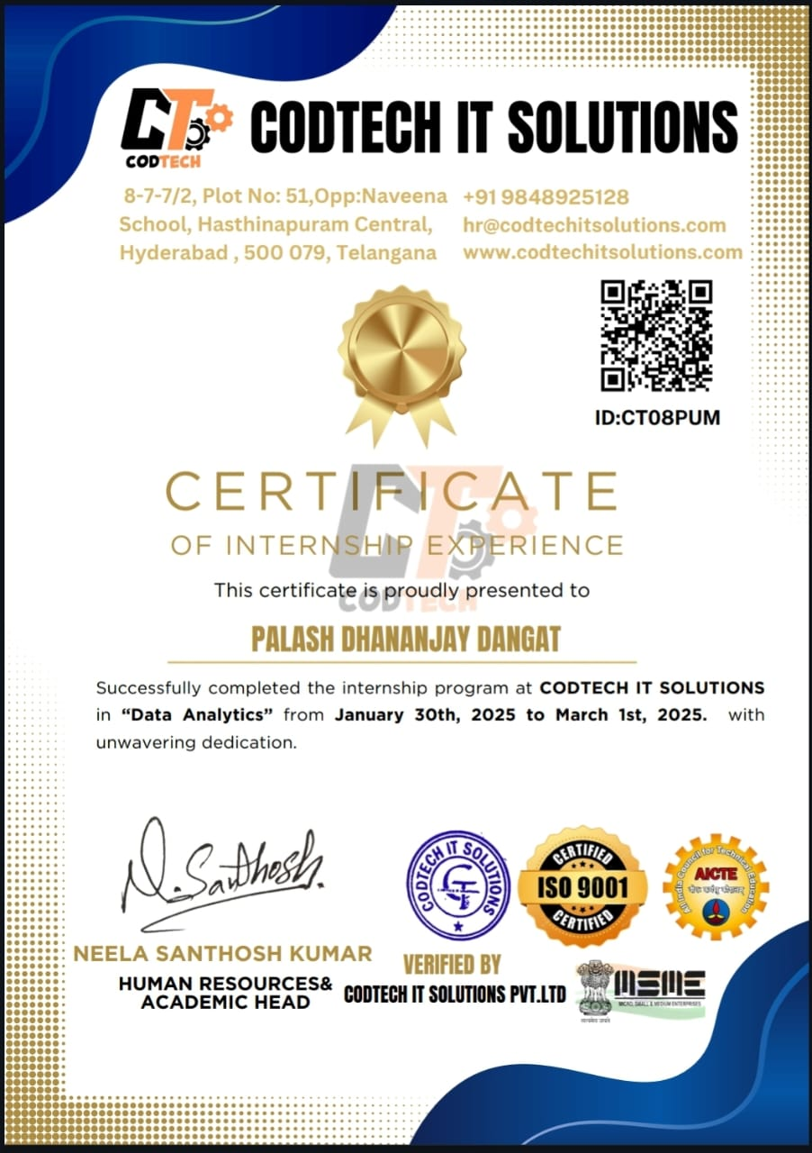
INTERNSHIP CERTIFICATE

Slide 9
References:
Mrs. Sravani
(Mentor)

Slide 10
THANK YOU!

